Slide 1
JIT121 Programming Principles
Lecture 5
Intro to GUIs

Slide 2
Goals of Lecture
Introduction to GUIs

Slide 3
GUI : Graphical User Interface
Most programs don't run via the command line – i.e. are not Console programs
GUI programming is the norm
  Based around a "window" or "form"
GUI programs are more user-friendly:
  user can point and click
  application can display pictures, graphics, etc.
  user can do any permissible action at any given time
    i.e. not a fixed sequence that is controlled by the program

Slide 4
Contrasting Windows Forms and Console Applications
Console applications
  Each line in Main() is executed sequentially (and that may involve calling other methods, each line of which is executed sequentially…) – then the program halts
Windows Forms applications
  Once started, the program sits and waits for some interaction from the user
  Internally, uses an event loop (or "message loop")

Slide 5
Event Driven Programming
Program sits "idle" and does nothing until some event is triggered (the event loop)
Event is a notification to the program that the user has done something
When an event happens (like a mouse click or keyboard entry) the program will execute some code
The code is a method (or methods) that has been associated with a particular event and is known as an "event-handler"

Slide 6
Systems.Windows.Forms
The Form is the basic "window" in a GUI application
Using the System.Windows.Forms namespace
We create a subclass of Form as a window for a GUI application

Slide 7
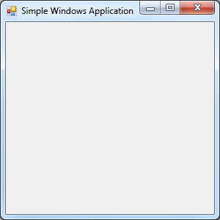
Systems.Windows.Forms
Into a window we can place any number of basic "controls":
- Buttons, Labels, TextBoxes, …
(Forms) synonyms: control, widget, object, variable
  Each of your forms inherits properties and methods from Form such as size, colour, location, etc.

Slide 8
Visual Studio Designer
Allows you to easily lay out and create a GUI
Simple drag and drop controls to design your GUI
You could use a text editor to type all the code to create the window and variables for the various controls, but the Forms Designer makes it easy to create the GUI
As you drag and drop controls onto your form, the Designer automatically generates the code to declare and instantiate these objects though you will need to give meaningful names to each and every control

Slide 9
VS Forms Designer
start a new Project as a Window Forms Application
  creates a class: Form1.cs
contains a method which calls InitializeComponent()
InitializeComponent() will eventually contain code which instantiates the control objects (Buttons, Labels etc) on the form and sets initial values of their various properties.
  code is generated automatically by the Designer
Execution still begins in Main(), in Program.cs

Slide 10
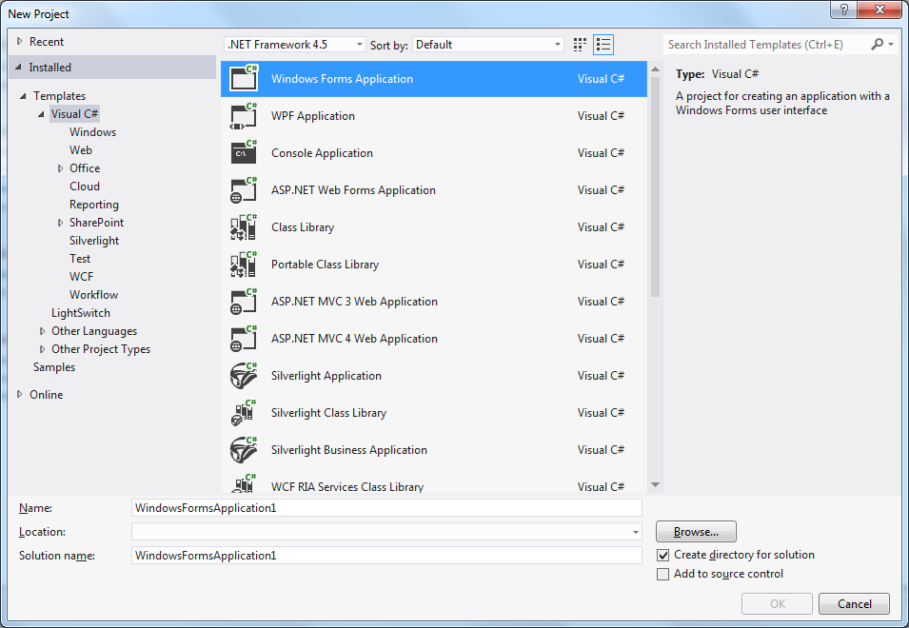
Forms and Visual Studio
Windows Forms Application template

Slide 11
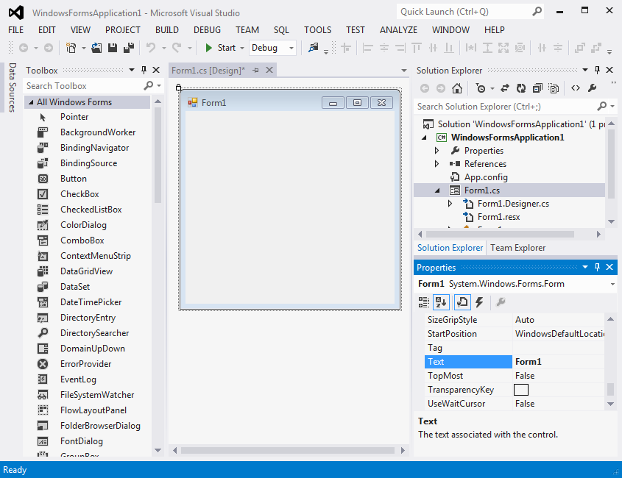
Initial Design Screen
Pushpin to dock window
Toolbox
Properties Window
Design View

Slide 12
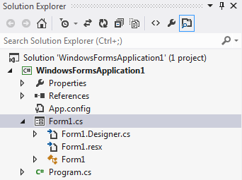
Files in a New Form
Expand Form1.cs node to reveal the Form1.Designer.cs file

Slide 13
Files in a New Form
Visual Studio separates the source code into three files:
  Form1.cs: The one that you normally edit
  Form1.Designer.cs: Holds the automatically-generated code; usually don’t edit
  Program.cs: Contains the Main() method, where the program execution always begins
    Call to Run() method places the application in an event loop

Slide 14
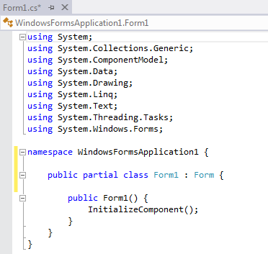
Form1.cs and Form1.Designer.cs both use partial class definitions, allowing the code for the Form1 class to be split across these two files
Using two files "protects" you from changing the automatically-generated code
This method contains the code generated by the Windows Forms Designer
  constructs the control objects on the form
  sets the initial values of their various properties

Slide 15
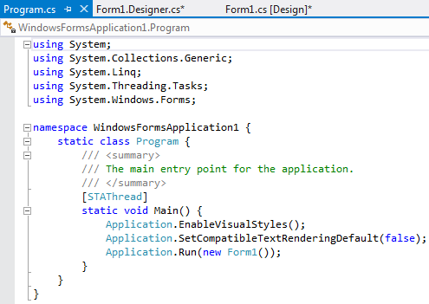
Execution starts in the Main() in the Program.cs

Slide 16
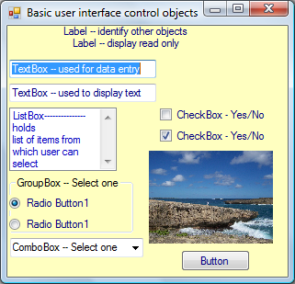
GUI Controls
(Doyle, 2014)

Slide 17
Controls
Windows Forms Designer allows you to drag and drop controls to your GUI
  Designer automatically generates code to instantiate the objects
A control is an element of a GUI that allows the user to interact with the GUI
Large number of types of controls, including:
  Button, Label, TextBox, ComboBox, MainMenu, ListBox, CheckBox, RadioButton
  Each comes with its own predefined properties and methods
  Each can trigger events

Slide 18
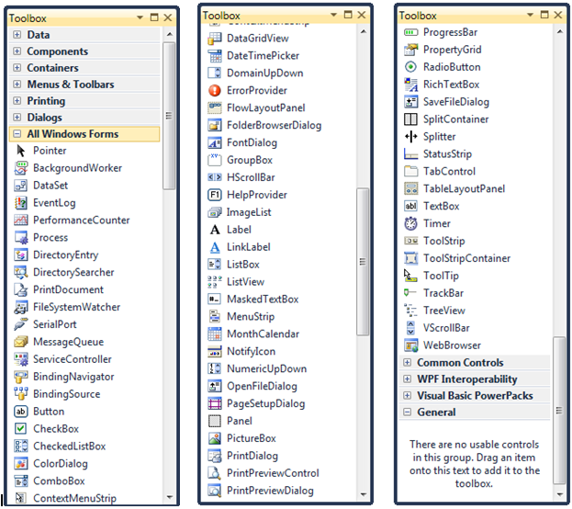
Many Kinds of Controls

Slide 19
Controls and Windows Forms Designer
Use the Designer to
  Move, align, resize and delete controls
Use the Properties window to change the value of a control attribute
  Select a property from the list in the Properties window and click on it to change
  Make controls enabled/disabled, visible/invisible etc.
Can also change control properties at runtime

Slide 20
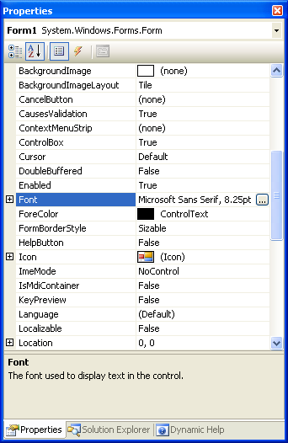
Windows Form Properties
Alphabetical
Events
Categorized
Properties
Properties window is context-sensitive
The properties change depending on what you have selected in the form
Property values
Description Pane: describes the selected property

Slide 21
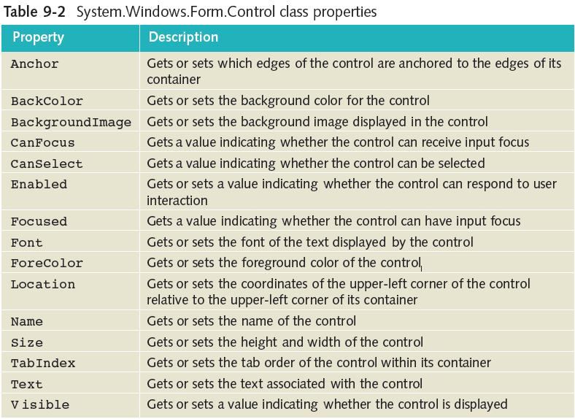
Some Properties of Every Control

Slide 22
Control Naming
Typical naming of a GUI controls
  Prefix name with the full name of the control OR with three letters defining the control, e.g. btn, lbl, txt
      helps make your code more readable
      If abbreviated, use this as a guide
Control | Typical Prefix | Control | Typical Prefix
Button | button/btn | RadioButton | radioButton/rad
TextBox | textBox/txt | ComboBox | comboBox/Cmb
Label | label/lbl | ListBox | listBox/Lst
CheckBox | checkBox/ckBox | GroupBox | groupBox/Grp

Slide 23
Steps to Create a GUI Application
Create a Windows Forms Application
Design your form (decide what controls you want)
  drag and drop controls from the Toolbox
Attach code to all of the events
  button_Click etc.
  event-handlers will call methods to perform the actual program logic (which is usually from another class)
Write the code to perform the actual task:
  GUI form will not be the only class in your program
  GUI is just how you get input from the user and output to the user
  Main functionality of your program will be in other classes

Slide 24
Activity: CelsiusConverter App
Let’s create a simple GUI for temperature conversion app
GUI will have various controls
  TextBox for input of temperature
  Button to click to do conversion
  A Label for the output the corresponding temperature
  Other Labels, providing info for the user
  it will look something like the next slide

Slide 25
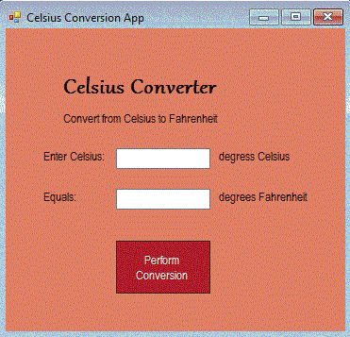
Activity: CelsiusConverter App
form
label
label
label
textBox
button
Form Properties: Text; BackColor; Font (changes all controls added to the form);
Label Properties: Text; BackColor; ForeColor; Font
TextBox Properties: Name; Text; TextAlign; Enabled
Button Properties: Text; Enabled; TabIndex; BackColour; ForeColour

Slide 26
Adding Event-Handler Code
If we run our GUI, nothing will happen
  The window appears, but none of the Buttons etc. will do anything
  The GUI is not "connected" to any program logic
  Need to connect the program logic to the GUI by adding the event handler methods
  Need to decide what events will occur and what must be done when an event happens

Slide 27
Adding Event-Handler Code
Need to add in the code for the method(s) that will be called when an event is triggered
There are three ways to link an event-handler method to the controls in Visual Studio:
  Double-clicking the control
    Creates a method header for the "default" event for the control type (e.g. buttonName_Click for Buttons)
  In the Properties window, select the Events button then double-click on the chosen event
    Adds a header for the event-handler method
  Writing your method, and then selecting it in the Events list (least preferred)

Slide 28
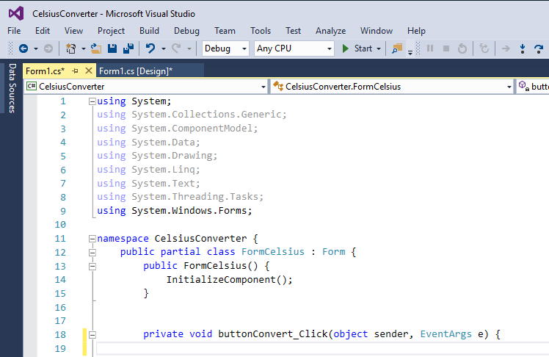
Example: Double clicking on Button

Slide 29
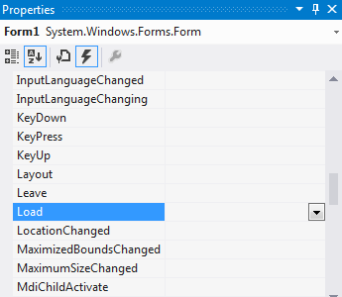
Windows Form Events
Events selected
Double-click to create an event handler

Slide 30
Example Form and Control Event-Handlers
For Forms:
  private void FormName_Load (object sender, EventArgs e)
  Triggered when the form is run (loaded)
  Can be used to initialise the items in ComboBoxes, ListBoxes, etc.
For Controls:
  private void buttonName_Click (object sender, EventArgs e)
  Such event-handler code can call methods in your program logic classes. This "connects" the GUI to your program classes.
Note that if you delete an event-handler method, you must delete this from the Designer.cs code also

Slide 31
Adding Code to the Conversion Button
When you double-click on the Button in Design View, an event-handler method heading is automatically created:
private void buttonConvert_Click(object sender, EventArgs e) {
And that method is automatically registered for the click event in the Designer.cs code:
this.buttonConvert.Click += new
System.EventHandler(this.buttonConvert_Click);

Slide 32
Conversion Button Functionality
Need to add code to the Conversion Button
  Read the text from the input TextBox
  Perform the calculation
  Display the answer in the output TextBox

Slide 33
Convert Button Functionality
Change this to TryParse. What should the program do if a non-numeric value is entered by the user?
private void buttonConvert_Click(object sender, EventArgs e) {
double celsius = double.Parse(textBoxInput.Text);
double answer = 0;
answer = (celsius * 9.0 / 5.0) + 32.0;
textBoxOutput.Text = answer.ToString();
  // Read the text from the input TextBox
  // Perform the calculation
  // Display the answer in the output TextBox

Slide 34
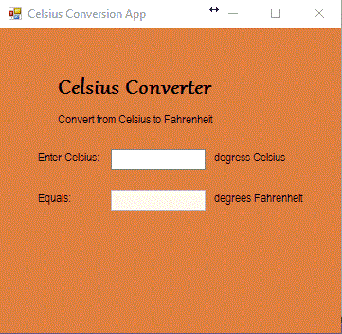
Design Considerations
When the program starts, we only want the user to be able to type the Celsius value
  Make the other controls not enabled or not visible initially using the Properties window
  Once a value is entered, enable the controls

Slide 35
Design Considerations
Add event handler for textBoxInput to make the button visible:
private void textBoxInput_TextChanged(object sender,
EventArgs e) {
buttonConvert.Visible = true;
}

Slide 36
MessageBox
A MessageBox is an easy way to get the user’s attention when something has gone wrong or when the user must be notified of something
Using the MessageBox.Show(string) method you can give the user a message
MessageBox.Show is heavily overloaded
When the MessageBox is displayed, the program cannot continue until the user has clicked the Button on the MessageBox

Slide 37
More GUI controls
TabControl
CheckBox

Slide 38
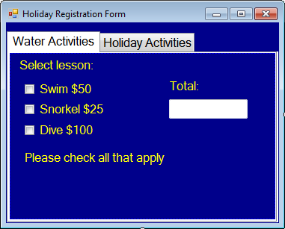
Example: Holiday Registration Form
TabControl
CheckBox

Slide 39
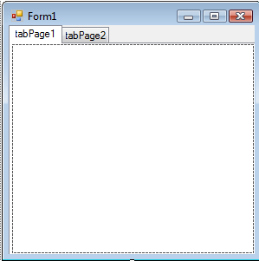
TabControl Controls
Sometimes a form requires too many controls for a single screen
A TabControl object displays multiple tabs
  Each separate tab can be clicked to display other options
  Add a TabControl object to the page by dragging the control from the Container section of the Toolbox
  Then stretch the TabControl to fill the form

Slide 40
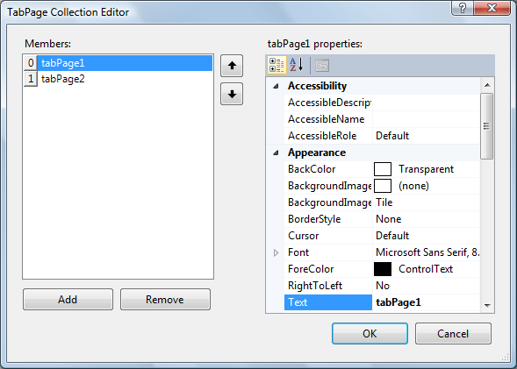
TabControl Properties
TabPage property enables you to format individual tabs
Clicking the ellipsis (…) beside the Collection value displays the TabPages Collection Editor

Slide 41
CheckBox Objects (review)
Appear as small boxes
  Allow users to make a yes/no or true/false selection
Checked property set to either True or False depending on whether a check mark is to appear or not
  Default value is False
CheckedChanged() is the default event-handler method
  Fired when CheckBox object state changes

Slide 42
Shared Event-Handlers
Each CheckBox could have a separate event-handler with similar code in each
But it's easier for code maintenance to associate one event-handler for all related CheckBoxes

Slide 43
Activity: Shared Event-Handlers (HolidayRegistrationPartial Project)
  Double-click on one of the CheckBoxes to create the default event-handler …_CheckedChanged()
  Change its name to something more appropriate/generic: "ComputeCost_CheckChanged"
  Change the event-handler name in the Form1.Designer.cs as well (VS shows 'potential fixes')
  Make that the event handler for the other check boxes too…

Slide 44
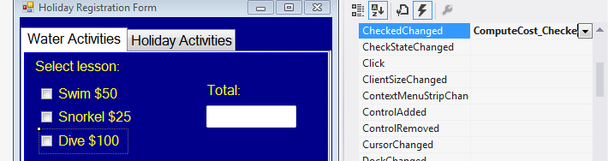
Activity: Using a Shared Event-Handler
  For each control that will be sharing the event-handler:
    In the Properties window, click on the Events button (lightning bolt icon)
    Find the event CheckChanged, and click on the down arrow to see all the available methods
    Select the method you've just created to handle the event

Slide 45
Activity:
Add code to the shared Event Handler
private void ComputeCost_CheckedChanged (object sender, System.EventArgs e) {
int cost = 0;
if (ckBoxSwim.Checked) {
cost += 50;
}
if (ckBoxSnorkel.Checked) {
cost += 25;
}
if (ckBoxDive.Checked) {
cost += 100;
}
txtResult.Text = cost.ToString("C");
}
Can check who sender is:
if (sender == ckBoxSwim)…

Slide 46
GroupBox Objects
A GroupBox object may be used to group CheckBox or RadioButton objects, e.g. see "Skill level" on the next slide.
  Can move or set properties that impact the entire group.
  CheckBox objects may be grouped together for visual appearance.
  With RadioButton objects, a GroupBox adds functionality – the user is allowed only one selection.
So that Visual Studio knows which controls are part of a group, GroupBox objects should be placed on the form before you add objects inside them.

Slide 47
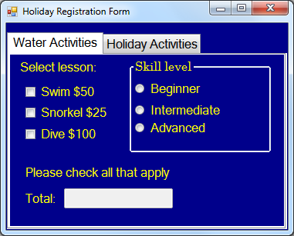
GroupBox and RadioButton Objects
GroupBox, with RadioButtons added
Add an empty Label here for message

Slide 48
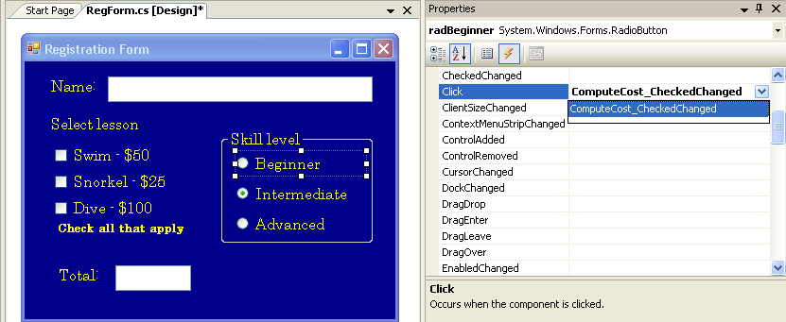
RadioButton Objects
Can set the default selection, e.g.
  this.radIntermed.Checked = true;
The RadioButton objects can also share the same event-handler
  just like the CheckBoxes

Slide 49
Activity: RadioButton Event Handler
Link all RadioButtons to the existing event handler: ComputeCost_CheckedChanged(…)
Add code to alter the cost according to the skill level, and change the message label text:
... // existing statements
if (radBeginner.Checked) {
cost +=10;
lblMsg.Text = "Beginner: Extra $10 charge";
} else if (radAdvanced.Checked) {
cost -=15;
lblMsg.Text = "Advanced: Discount $15";
} else {
lblMsg.Text = "";
}

Slide 50
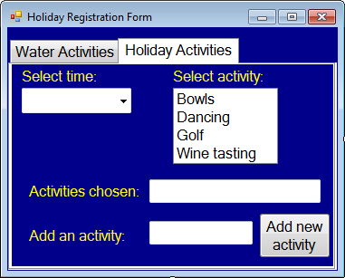
Holiday Activities Tab
ComboBox
ListBox

Slide 51
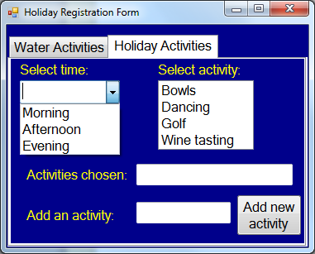
ComboBox Objects
ComboBox
Top line is blank in ComboBox when DropDownStyle property is set to DropDown

Slide 52
ComboBox Control
Displays a text box combined with a list, which enables the user to select items from the list or enter a new value.
User can select from list, or add a new value
Can add or remove items at design time or dynamically at run time.
Includes number of properties and events
  Items property is used to set initial values
    Click on (Collections) to add items

Slide 53
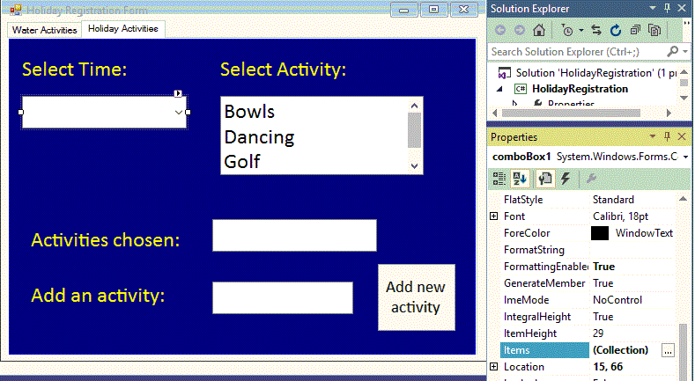
Adding an Item to a ComboBox
Add ComboBox control, then click on Items (Collection) property to type entries
String Collection Editor

Slide 54
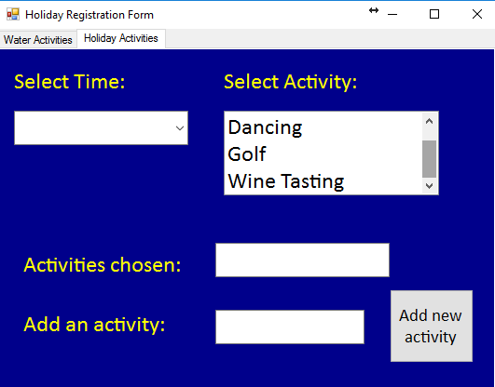
ListBox Objects
ListBox
Scroll bar appears if list bigger than control

Slide 55
ListBox Control
Displays a list of items for the user to select single or multiple items.
  Scroll bar is automatically added when total number of items exceeds the number that can be displayed
Can add or remove items at design time or dynamically at run time.
Includes number of properties and events
  Items property is used to set initial values
    Click on (Collections) to add items

Slide 56
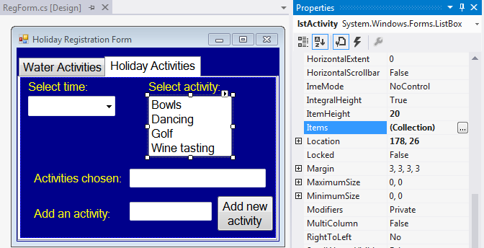
Adding an Item to a ListBox
Add ListBox control, then click on Items (Collection) property to type entries
String Collection Editor

Slide 57
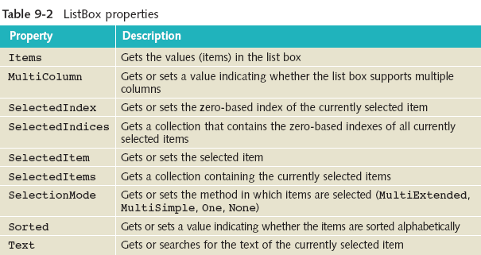
Some Useful ListBox Properties
(Doyle, 2014)

Slide 58
ListBox Control
Sorted property
  Can set to True, to avoid having to type values in sorted order
Registering event-handlers for the ListBox
  Might want to know when the item selection changes
  SelectedIndexChanged is the default event for ListBox
  !When designing a form, double-clicking on any control registers its default event for the control

Slide 59
ListBox Control Event Handler
Its event is registered with the System.EventHandler delegate:
  this.listBoxActivities.SelectedIndexChanged += new System.EventHandler (this. listBoxActivity_SelectedIndexChanged);
Visual Studio adds skeleton event-handler method:
  private void listBoxActivities_SelectedIndexChanged
  (object sender, System.EventArgs e) {
  ...
  }

Slide 60
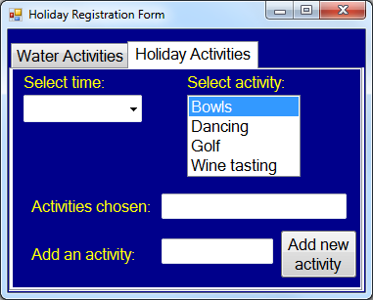
ListBox SelectedIndexChanged event fired

Slide 61
ListBox Control
To retrieve string data from ListBox use its Text property
  textBoxActsChosen.Text = listBoxActivities.Text;
  Place in the body of the event-handler method
  When the event fires, the selection is retrieved and stored in the ListBox object

Slide 62
Multiple Selections with a ListBox
SelectionMode Property can be set to any of these values:
  None – no items can be selected.
  One – only one item can be selected.
  MultiSimple – multiple items can be selected, but:
    The only way to make a selection is to use the spacebar and/or click the mouse
  MultiExtended – multiple items can be selected, and
    Can also use Ctrl key, Shift key, arrow keys and mouse
    Normally use this one when multiple selections allowed

Slide 63
Multiple Selections with a ListBox
When a ListBox object allows multiple selections, the Text property ONLY gets the first one selected.
Use SelectedItems (or SelectedIndices) to retrieve a collection of items selected.
For example, retrieving the selected data:
  string result = "";
  foreach (string activity in listBoxActivities.SelectedItems) {
  result += activity + " ";
  }
  textBoxActsChosen.Text = result;

Slide 64
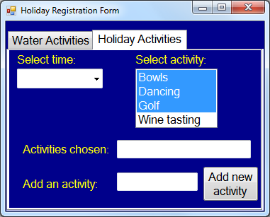
Multiple Selections within a ListBox

Slide 65
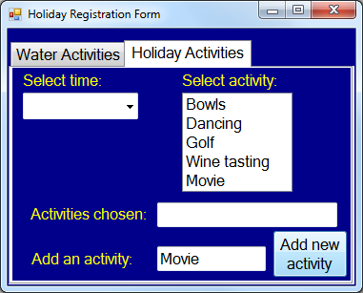
Adding new items to a ListBox's collection
Add() method called inside the buttonClick event

Slide 66
Adding new items to a ListBox
Add items to a ListBox at run time by using Add() method with the Items property
    listBoxActivities.Items.Add("string value to add");
For example:
  private void buttonAddActivity_Click(object sender, System.EventArgs e) {
  listBoxActivities.Items.Add(txtNewActivity.Text);
  }

Slide 67
Output of strings with placeholders via MessageBox.Show( … )
All 21 overloaded Show methods require a string argument
  MessageBox.Show("This is a some message");
Unlike Write or WriteLine cannot use strings with placeholders or string concatenation directly as an argument.
Solution: enclose the string as argument to Format method of string
  string.Format(" ….. {0}", variable)
MessageBox.Show(string.Format("Your chosen dining option is {0}", whichOption));

Slide 68
ToolTip Control
Tool tips can be used for Menus, TextBoxes,… so that a usage tip is displayed when the cursor rests on top of the control.
  Drag ToolTip control from toolbox and place it anywhere on the Form.
  It will be displayed in the component tray below the Form
  Now all controls will have an additional Property, "ToolTip on toolTip1”. Enter the text you want displayed for that control.

Slide 69
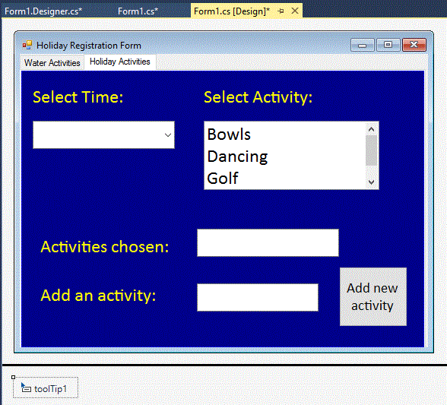
Activity: Add a ToolTip

Slide 70
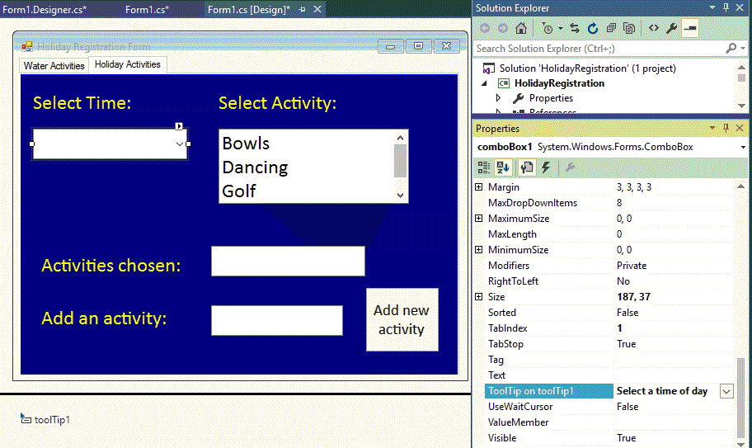
Activity: Add a ToolTip

Slide 71
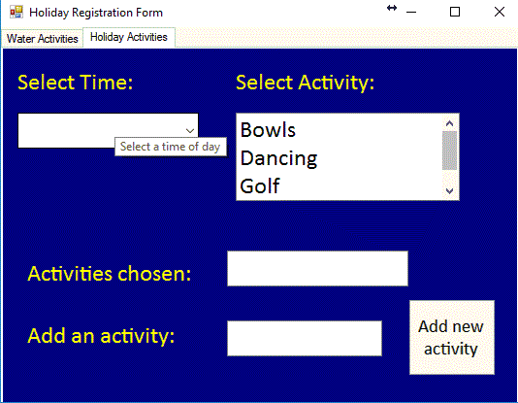
Activity: Add a ToolTip

Slide 72
Tab Index
When filling in a "form" online, it is common to move between fields using the Tab key
The order in which a control is added to a Form defines it TabIndex Property
With the Form selected in Design view, select Tab Order from the View Menu to display the TabIndex of all controls.
  Even Labels have a TaxIndex (irrelevant).
Usually the controls will not be in the actual order you want a user to proceed through the form.
Change by clicking on the controls in the required order, or change the TabIndex property of each control

Slide 73
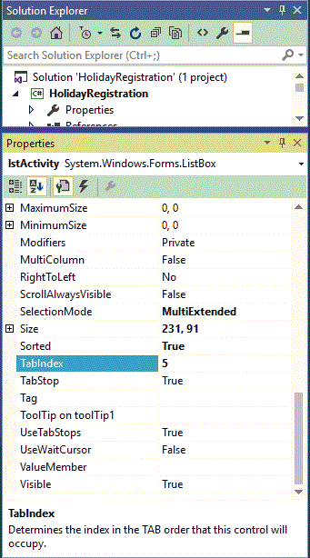
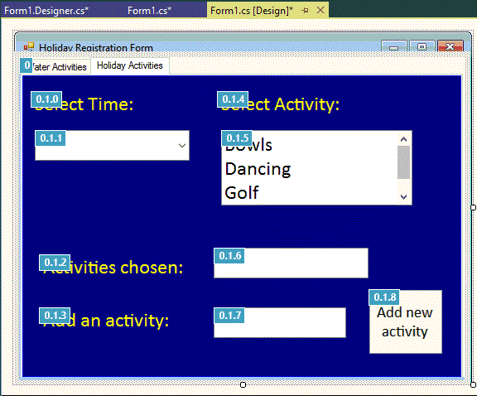
Tab Index

Slide 74
Menus
When designing a GUI application, it is important to cater for different styles of user interaction:
  Mouse pointing and clicking – for fairly inexperienced users
  Menu Based interaction – for intermediate users
  Keyboard shortcuts – for more experienced users
Can add a menu with the Forms Designer from the Toolbox window
  Drag and drop a MenuStrip onto your form
  Simply type in the Menu commands – give each item a descriptive name!
Can then add event-handler code to each menu item

Slide 75
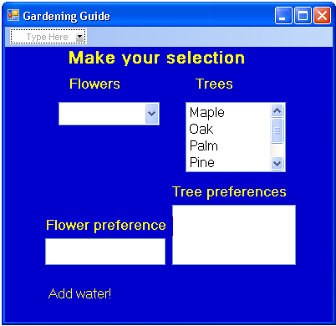
Menus
Drag a MenuStrip control to your form, then click here to display Menu structure
First step when creating a menu

Slide 76
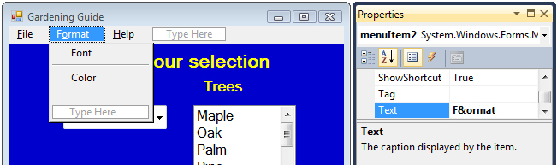
Menu Shortcut
Type an ampersand (&) between the F and o for the Format item, to make Alt+o the shortcut for Format

Slide 77
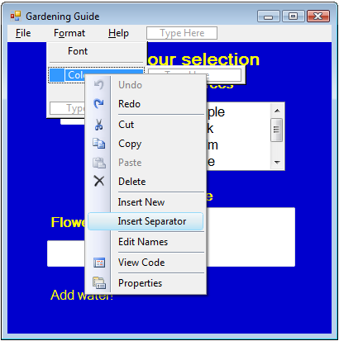
Menu Separators
To create separators, right-click on the text label (below the needed separator)
Select Insert Separator
JIT121

Slide 78
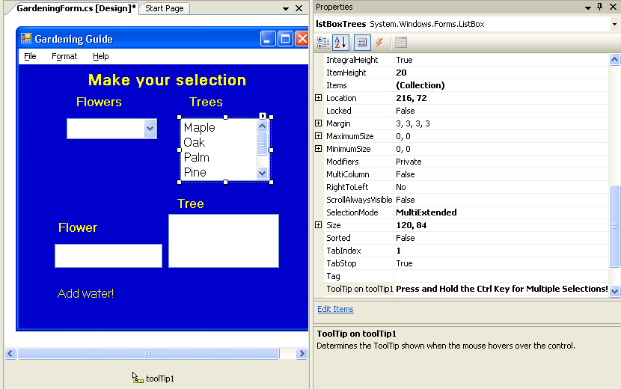
Menu Properties
Set the text to be displayed
when the cursor hovers over the control

Slide 79
Menu Event-Handler Methods
Set the Name property for each menu item, first.
Create event-handlers by double-clicking on the Menu item.
When the user clicks the menu item, the event is triggered (or "fired").

Slide 80
Aside: Displaying a Form
Form displayed first when your program is run is chosen by the Main() method
Can display another form using the Show()method
Can also use the ShowDialog()method:
  displays the form in “dialog” mode
  effectively halts the program until the user closes it
  form will close when a specified button is pressed
  returns a value of type DialogResult (enumerated type – OK, Yes, No etc)
The return value can then be tested in the calling code to decide what action to take

Slide 81
Questions??

